Slide 1
Object Oriented Programming
Module 2 -
(Part2)
Prepared by
Renetha J.B.
Prepared by Renetha J.B.
‹#›

Slide 2
Topics
Core Java Fundamentals:
Returning Objects
Recursion
Access Control
Static Members
Prepared by Renetha J.B.
‹#›

Slide 3
Returning objects
A method can return any type of data,
  Primitive data (int ,float, char, double etc.)
  class types(objects) that we create.
  etc.
Prepared by Renetha J.B.
‹#›

Slide 4

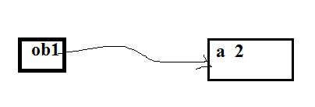

// Returning an object.
class Test {
int a;
Test(int i)
{
a = i;
}
Test increase()
{
Test temp = new Test(a+10);
return temp;
}
}
class RetOb {
public static void main(String args[]) {
Test ob1 = new Test(2);
Test ob2;
ob2 = ob1.increase();
System.out.println("ob1.a: " + ob1.a);
System.out.println("ob2.a: " + ob2.a);
ob2 = ob2.increase ();
System.out.println(“increase ob2.a: ” +ob2.a);
}
}
OUTPUT
ob1.a: 2
ob2.a: 12
increase ob2.a: 22
Prepared by Renetha J.B.
‹#›

Slide 5
Recursion
Recursion is the process of defining something in terms of itself.
A function that calls itself is called recursive function.
Prepared by Renetha J.B.
‹#›

Slide 6
// A simple example of recursion.
class Factorial {
  int fact(int n)
  {
    int result;
    if(n==1)
    return 1;
    result = n* fact(n-1) ;
return result;
}
}
class Recursion {
public static void main(String args[]) {
Factorial f = new Factorial();
int s= f.fact(3)
System.out.println("Factorial of 3 is " + s);
}
}
‹#›
Prepared by Renetha J.B.

Slide 7
Example
class Recursion2 {
public static void main(String args[]) {
RecTest ob = new RecTest(5);
int i;
for(i=0; i<5; i++)
ob.values[i] = i;
ob.printArray(5);
}
}
class RecTest {
int values[];
RecTest(int i) {
values = new int[i];
}
void printArray(int i) {
if(i==0)
return;
else
printArray(i-1);
System.out.println("[" + (i-1) + "] " + values[i-1]);
}
}
Prepared by Renetha J.B.
‹#›

Slide 8
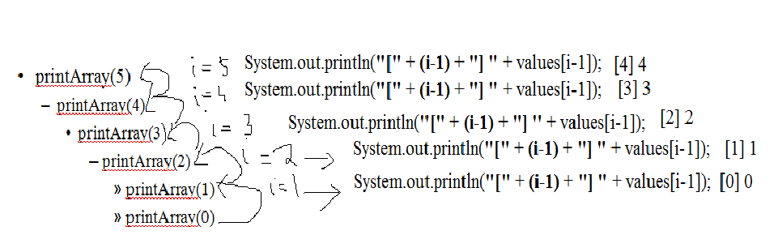
OUTPUT
[0] 0
[1] 1
[2] 2
[3] 3
[4] 4
[5] 5
Prepared by Renetha J.B.
‹#›

Slide 9
Access Control
Through encapsulation, we can control what parts of a program can access the members of a class.
  By controlling access, you can prevent misuse.
How a member can be accessed is determined by the access specifier that modifies its declaration
Java’s access specifiers are
  public
  private
  protected
  default
Prepared by Renetha J.B.
‹#›

Slide 10
Access Control(contd.)
When a member of a class is modified by the public specifier, then that member can be accessed by any other code. (ACCESSIBLE TO ALL)
  public int i;
When a member of a class is specified as private, then that member can only be accessed by any members of the same class.
  private int a;
Prepared by Renetha J.B.
‹#›

Slide 11
Access Control(contd.)
When a member of a class is specified as protected , then that member can be accessed within the package and by any of its subclasses.
protected char c;
When no access specifier is there, then its access specifier is default.
  It can be accessed within its own package, but cannot be accessed outside of its package
  int c;
Prepared by Renetha J.B.
‹#›

Slide 12
Access specifier-E.g.
class A{
  public int i;
  private double j;
  protected char c;
  float f; //default access
  public int myMethod(int a, char b) //public method
  { //..
  }
}
Prepared by Renetha J.B.
‹#›

Slide 13
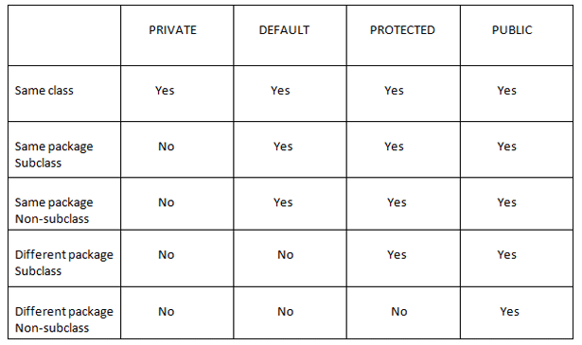
SAME CLASS
SAME PACKAGE,
SAME PACKAGE
,
ANY SUBCLASS
ALL
Prepared by Renetha J.B.
‹#›

Slide 14
class Test
{
int a; // default access
public int b; // public access
private int c; // private access
void setc(int i) //setter
{
c = i;
}
int getc() //getter
{
return c;
} }
class AccessTest {
public static void main(String args[]) {
Test ob = new Test();
ob.a = 10;
ob.b = 20;
// ob.c = 100; // Error! // PRIVATE
// You must access private variable c //through its methods
ob.setc(100); // OK
System.out.println("a=“+ ob.a);
System.out.println("b="ob.b”);
System.out.println(“c= " + ob.getc() );
}
}
Prepared by Renetha J.B.
‹#›

Slide 15
static Members
Usually we access the member of another class using object. Syntax is: objectname.member;
If we want to access a member of another class without using object, then we have to make it a make it a static member.
  Static class member is independent of any object of that class. We can make a member static by preceding the member declaration with the keyword static.
  static datatype member;
Prepared by Renetha J.B.
‹#›

Slide 16
static Members(contd.)
When a member is declared static, it can be accessed before any objects of its class are created, and without reference to any object.
Static member can be accessed using
classname.member;
Prepared by Renetha J.B.
‹#›

Slide 17
static Members(contd.)
The most common example of a static member is main function.
  main( ) is declared as static because it must be called before any objects is created.
Instance variables declared as static are global variables.
When objects of its class are declared, separate copy of a static variable is NOT made.
All instances(objects) of the class share the same static variable.
Prepared by Renetha J.B.
‹#›

Slide 18
static Members(contd.)
Methods declared as static(static methods) have several restrictions:
  static methods can only call other static methods.
  static methods must only access static data.
  static methods cannot refer to this or super.
Prepared by Renetha J.B.
‹#›

Slide 19
static Members(contd.)
If we need to do computation to initialize your static variables, we can declare a static block that gets executed exactly once, when the class is first loaded.
Prepared by Renetha J.B.
‹#›

Slide 20
// Demonstrate static variables, methods, and blocks.
class UseStatic {
static int a = 3;
static int b;
static void show(int x) {
System.out.println("x = " + x);
System.out.println("a = " + a);
System.out.println("b = " + b);
}
static {
System.out.println("Static block initialized.");
b = a * 4;
}
public static void main(String args[])
{show(42);
}
}
OUTPUT
Static block initialized.
x = 42
a = 3
b = 12
Prepared by Renetha J.B.
‹#›

Slide 21
Working of e.g. code
As soon as the UseStatic class is loaded, all of the static statements are run.
  First, static member a is set to 3,
  then the static block executes, which prints a message and then initializes b to a * 4 or 12.
  Then main( ) is called, which calls show( ), passing 42 to x.
  The three println( ) statements in show refer to the two static variables a and b, as well as to the local variable x.
Prepared by Renetha J.B.
‹#›

Slide 22
if we want to call a static method from outside its class, we can do so using the following general form:
classname.method( )
Here classname is the name of the class in which the static method is declared.
Prepared by Renetha J.B.
‹#›

Slide 23
Non-static method invocation
class Demo {
int a = 42;
int b = 99;
void callme()
{
System.out.println("a = " + a);
}
}
class Sample {
public static void main(String args[]) {
Demo dm=new Demo ();
dm.callme();
System.out.println("b = " + dm.b);
} }
Prepared by Renetha J.B.
‹#›

Slide 24
static method invocation
class StaticDemo {
static int a = 42;
static int b = 99;
static void callme()
{
System.out.println("a = " + a);
}
}
class StaticByName {
public static void main(String args[])
{
StaticDemo.callme();
System.out.println("b = " + StaticDemo.b);
} }
Prepared by Renetha J.B.
‹#›

Slide 25
Nonnstatic members static members
class Demo {
int a = 42;
int b=5;
void callme()
{
System.out.println("a = " + a);
}
}
class Sample {
public static void main(String args[]) {
Demo dm=new Demo();
dm.callme();
System.out.println("b = " + dm.b);
} }
class StaticDemo {
int a = 42;
static int b = 5;
static void callme()
{
System.out.println("a = " + a);
}
}
class StaticByName {
public static void main(String args[])
{
StaticDemo.callme();
System.out.println("b = " + StaticDemo.b);
} }
Prepared by Renetha J.B.
‹#›

Slide 26
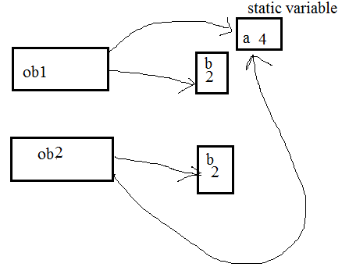
class Sample
{
static int a = 0;
int b;
Sample()
{
b=0;
}
void callme()
{
a=a+2;
b=b+2;
System.out.println("static after +2 a = " + a);
System.out.println("b after +2 = " + b);
}
}
class Samplestat {
public static void main(String args[])
{
Sample ob1=new Sample();
System.out.println("ob1");
ob1.callme();
Sample ob2=new Sample();
System.out.println("ob2");
ob2.callme();
} }
OUTPUT
ob1
static after +2 a = 2
b after +2 = 2
ob2
static after +2 a = 4
b after +2 = 2
Prepared by Renetha J.B.
‹#›

Slide 27
Reference
Herbert Schildt, Java: The Complete Reference, 8/e, Tata McGraw Hill, 2011.
Prepared by Renetha J.B.
‹#›

